Slide 1
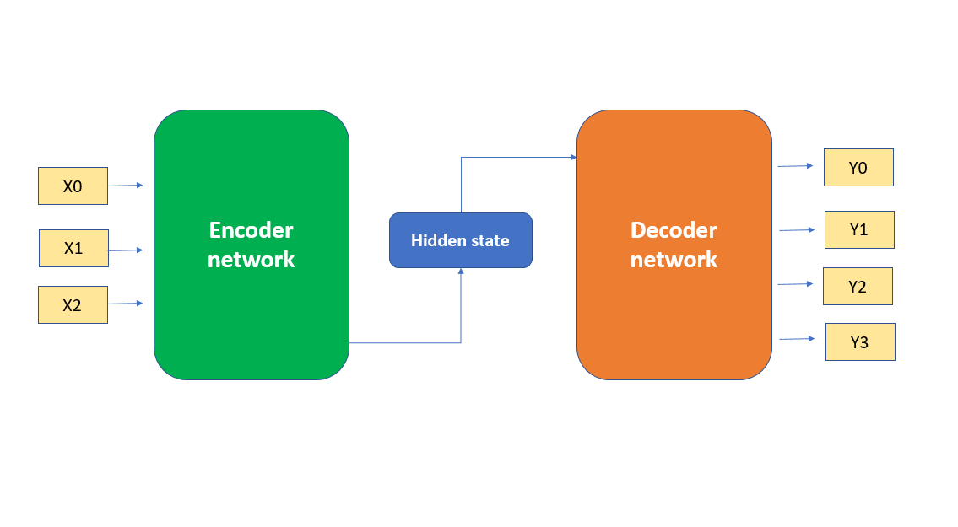
Model Training
Model used Pix2Struct base.
Official paper: here.
Architecture

Slide 2
Why Pix2Struct?
Why NOT default Pix2Struct?
Transformer based
Encoder Decoder architecture is proven
Visual understanding is achieved for high resource languages
Base model with 282 Million parameters
Arabic not supported (Right to Left)

Slide 3
Training process
Pretraining (~ 3-4 Million documents)
OCR
Masked Prediction
General Training (~ 500K documents)
Text Extraction Questions
Fine-tuning
Customer data text extraction questions

Slide 4
Training Data
What is lacking?
Publicly Available datasets were quite low
Artificially created data using different fonts and templates
Manually created document data
Long text answers data
Visual understanding samples in Arabic
Handwritten data

Slide 5
Pre-Training infrastructure
Post-Training infrastructure
5 x 8A100 GPUs MultiNode training
Using AWS Sagemaker
Took around 4 iterations, 2 weeks per iteration
3 x 8A100 GPUs MultiNode training
Took around 2 iterations, 2-3 days per iteration

Slide 6
Training data pipeline
Converts PDFs to Images
This step is done in the python file of convert_certificates.py
Sometime conversion of PDF documents to Images results in very large images
Alternative approaches can be taken for this like using CLI tools in linux pdf2ppm etc.
Create a JSON file with list of JSON objects with “image_name”, “question” and “answer” as keys.
Questions while training were not augmented but this step can also be done in order to improve robustness of the model output. E.g. What is the data? What date is mentioned? Date of the document? etc.

Slide 7
Fine-tuning Script parameters
MAX_PATCHES (3584) currently set to (3072)
MAX_LENGTH (256 max length of answer text)
BATCH_SIZE (Set according to the GPU memory)
NUM_GPUS (Set according to number of GPUs in VM)
NUM_EPOCHS (2-5 Experimental approach to get best results)
LR (learning rate, generally should not change at all)

Slide 8
Helpful Training Procedure
Make sure training data is accurate
Make sure image files created by the step from PDF to image are valid and not corrupt in any sense.
Make sure GPU is being used while fine-tuning
If GPU usage is low this might be because data reading speed is becoming the bottleneck.
Diverse data is much better than a lot of the same data.
Balancing the dataset
If a question has answer which are just yes or no then have equal amounts of samples in for yes and no answers.

Slide 9
Accuracy Measurement
Accuracy can be measured by each token (characters) or by the whole output
Depends on the use-case
Should take into consideration that model might make mistakes in some characters so if any sort of post-processing can be done the accuracy should be calculated after the post-processing is done to get realistic results. E.g. if actual output was “01/01/2024” but model gave “01/01/2024 a” then a can be removed if a date is expected and then accuracy should be measured.
Common metrics are edit distance (levenshtein distance) for the output which means how many characters will have to be edited/added/removed to form the actual output.

Slide 10
Post-Processing steps
In server.py if any post-processing steps are required can be added after the model output is received
or
Alternatively if you are calling the API with your own codebase then post processing can be added at that point as well.

Slide 11
Continuous training in production?
Logging model output and ground truth
Aggregating documents where model output and ground truth differed.
Fine-tuning the model with the new data + old training data
Testing the new model in dev environment vs production environment
Deploying the new model in production environment

